Slide 1
Openshift As Data Platform
Rafael
Shon Paz,
Solution Architect, IGC
Red Hat
Medium Account
Github Account
Linkedin Account

Slide 2

Notes:
Red Hat Manages the complexity for you
with HW vendors (HPE, DellEMC, …)
with the OpenSource Communities
with ISVs (SAP, …)
Value of Subscriptions

Slide 3
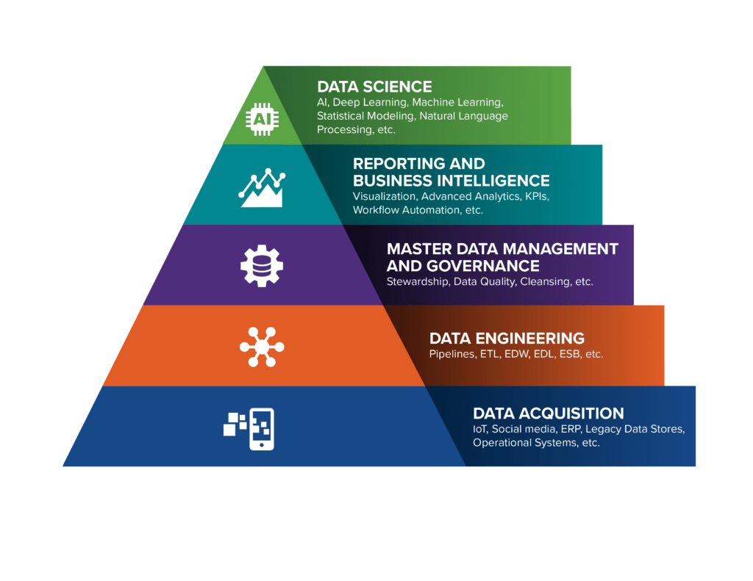
DIKW Pyramid
Data -> Information -> Knowledge -> Wisdom
Notes:
Data-Information-Knowledge-Wisdom
https://sensecorp.com/data-science-pyramid/

Slide 4
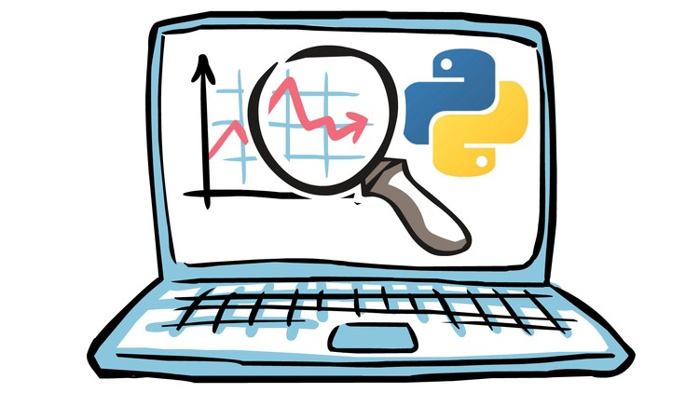
The basics of Data
Data Collection
The process of gathering and measuring information on targeted variables in an established system.
Data Engineering
the aspect of data science that focuses on practical applications of data collection and analysis.
Data Science
An inter-disciplinary field that uses scientific methods, processes, algorithms and systems to extract knowledge and insights from many structural and unstructured data.
Notes:
Source: Wikipedia

Slide 5






Data lifecycle and key personas
Set goals
Gather and prepare data
Develop ML model
Deploy ML models in app dev process
Implement
Apps & inference
ML models Monitoring & Management
Business leadership
Data engineer
Data scientists
App developer
IT operations

Slide 6
The potential

Slide 7





How businesses are using Data
Healthcare
Financial services
Government
Energy
Manufacturing and logistics
Mobile apps for patients and clinicians
Patient records and hospital equipment management
Fraud detection & risk analysis
Mobile banking
Mobile and web apps for citizen services
Geospatial analytics
Commercial off-the-shelf apps
Forecasting customer needs
Asset tracking
Inventory management
Notes:
Here are examples of business outcomes achieved by organizations across various industries because of databases & data analytics on containers & Kubernetes.
****Note to the speaker: Highlight a few of these depending on the relevance to the customers industry & business problems that we may have discovered already****

Slide 8
It can’t always be rosy

Slide 9



Data execution challenges
Unavailability of infrastructure & software
Talent shortage
Readily usable data lacking
Lack of collaboration across teams
Lack of key skills make it difficult to find and secure talent to maintain operations.
Lots of data is collected, but finding and preparing the right data is difficult.
Unable to implement quickly due to slow, manual and siloed operations.
No rapid availability of infrastructure and software tools slows data scientists and developers

Slide 10








Kubernetes to the Rescue
Set goals
Gather and prepare data
Develop ML model
Deploy ML models in app dev process
Implement Apps and inference
ML models monitoring & management
ML Software tools
Data Services - Databases (SQL, NoSQL, etc.), Data Lake, etc.
Hybrid, Multi Cloud Platform with self service capabilities
Compute Acceleration (GPU, FPGA, TPU)
Software-defined Infrastructure

Slide 11
Why containers and Kubernetes?

Slide 12



Why containers and Kubernetes?
Agility
Portability
Flexibility
Scalability
Respond quickly with automated compute resource management.
Develop and deploy ML models consistently across data center, edge, and public clouds.
Provision AI/ML environments as and when you need them.
Autoscaling and high availability of the AI/ML solution stack.

Slide 13


Slide 14

Operators simplify management of complex applications
on Kubernetes
●
Encode human operational knowledge
●
Automatically patch, upgrade, recover, and tune
container-based apps and services
●
Kubernetes-native
●
Purpose-built for a speciﬁc application or service
●
Enable “day 2” management

Slide 15



Phase I
Phase II
Phase III
Phase IV
Phase V
Basic Install
Seamless Upgrades
Full Lifecycle
Deep Insights
Auto Pilot
Automated application
Patch and minor version
App lifecycle, storage
Metrics, alerts, log
Horizontal/vertical scaling,
provisioning and
upgrades supported
lifecycle (backup, failure
processing and workload
auto conﬁg tuning, abnormal
conﬁguration management
recovery)
analysis
detection, scheduling tuning

Slide 16
Our Strategy

Slide 17
Partners

Slide 18

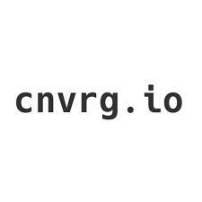



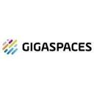




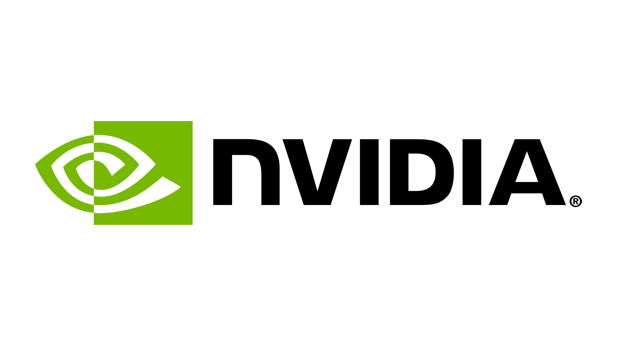
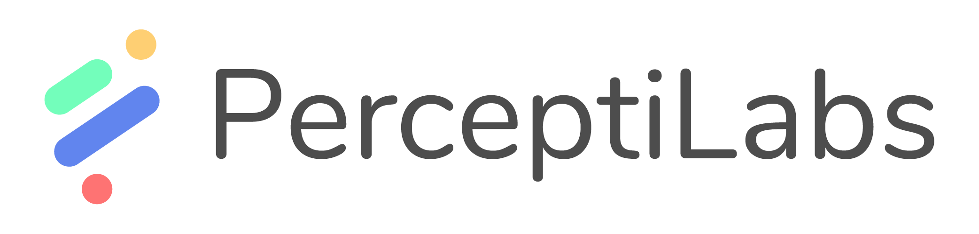




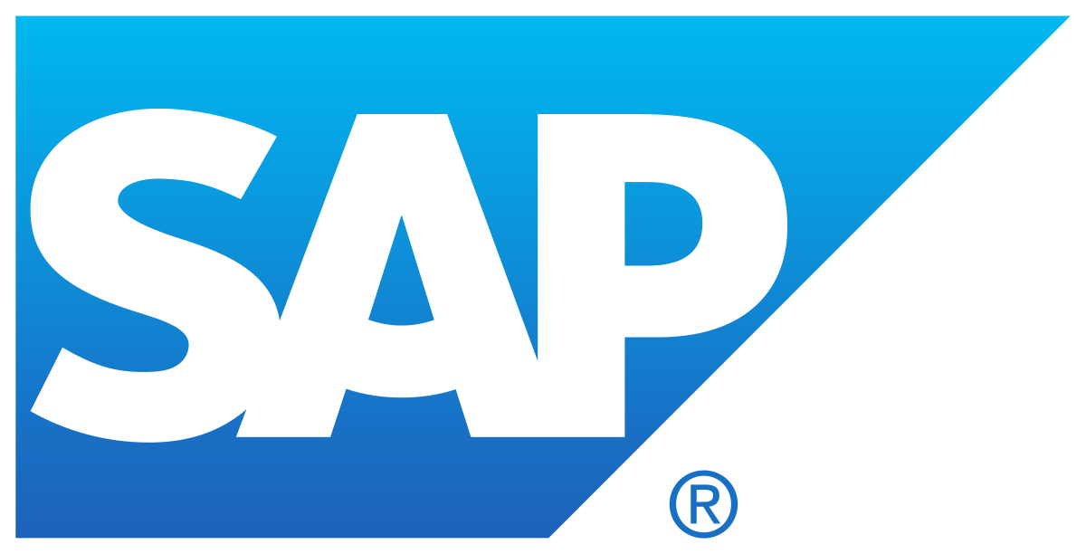
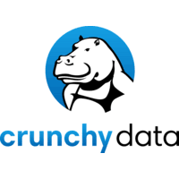
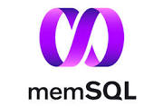




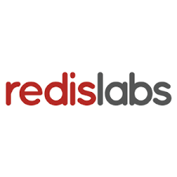



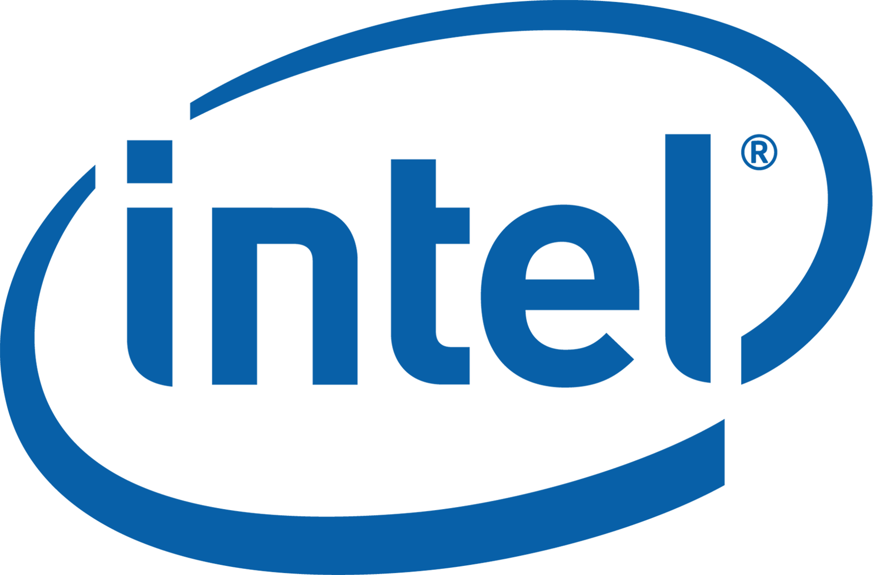


Strategic partnerships within AI/ML ecosystem
AI/ML Lifecycle
Data Governance & Security
Labs.ai
Data Processing
Data Analytics
Databases
AI Ops
Infrastructure Partners
Hardware Acceleration
Notes:
Listed alphabetically. Includes all OCP certified as well as ISVs with public announcements (SAS, Cloudera), and hw providers with published AI content

Slide 19
Openshift Data Science

Slide 20

Based on Open Data Hub and Operate First
Overview of Red Hat OpenShift Data Science
Upstream code enhanced with operational excellence
Open Data Hub
Community driven upstream meta-project demonstrating AI/ML platform on Red Hat OpenShift comprised of open source projects
Operate First
Subset Open Data Hub operated at scale for community and university audiences to infuse operational excellence
Red Hat OpenShift Data Science
Subset of Operate First delivered as a cloud service on Red Hat OpenShift Managed on Amazon Web Services with optional ISV offerings
Open Data Hub: https://opendatahub.io
Operate First: https://openinfralabs.org/ and https://www.operate-first.cloud/
Notes:
As I mentioned, we are taking advantage of the success we have had with Open Data Hub and the feedback we have heard from our customers and partners in what we are offering in Red Hat OpenShift Data Science.
At its core, we are delivering common data science tools like Jupyter notebooks and common packages and frameworks such as TensorFlow and PyTorch as the foundation of an AI as a Service Platform. Being able to operationalize those models using source-to-image technology and underlying that with GPU acceleration. All combined with a shared UI for navigation, onboarding, and exploring Red Hat portfolio and partner options.

Slide 21




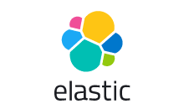


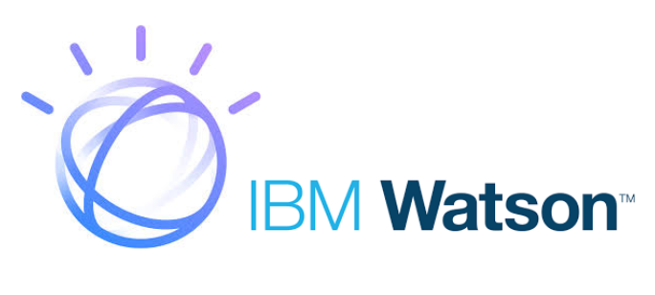

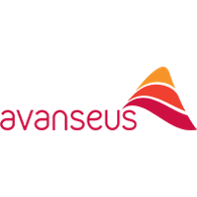






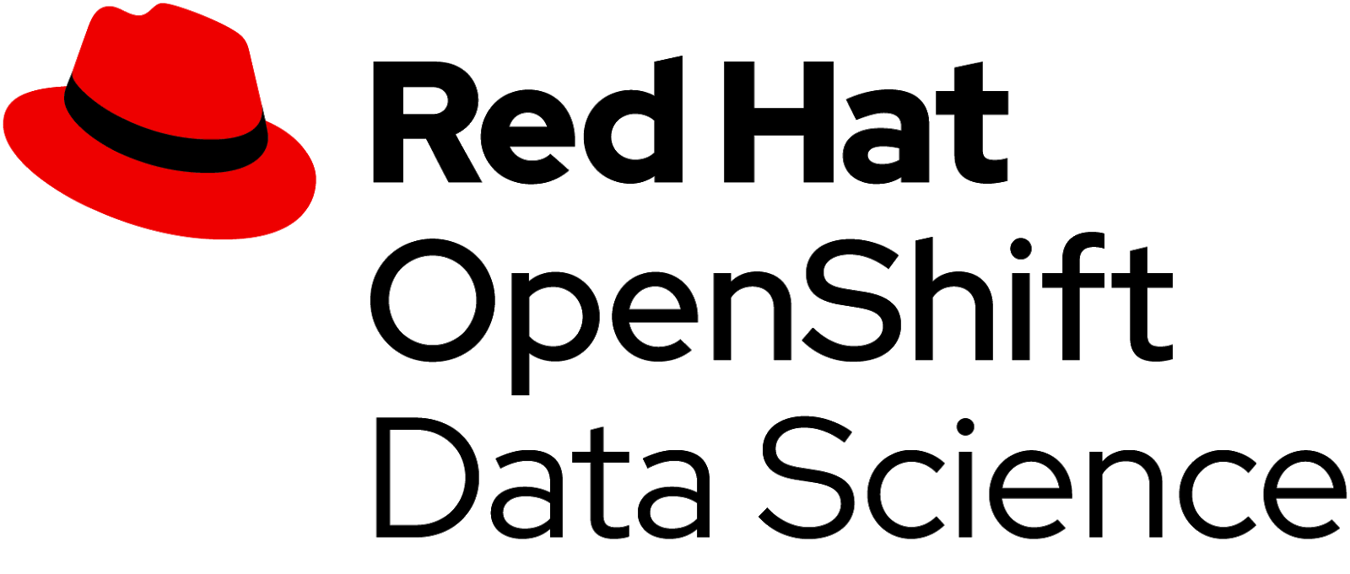
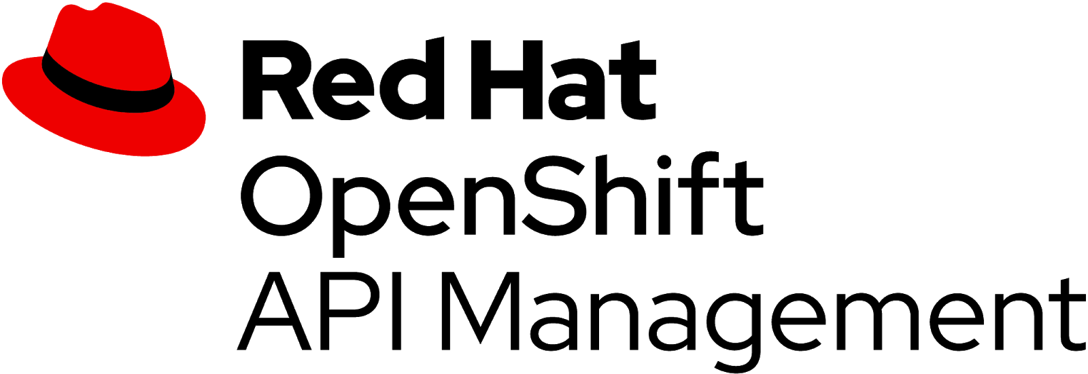


… and integrating our partner ecosystem
Overview of Red Hat OpenShift Data Science
Retrain models
Gather and prepare data
Develop model
Integrate models in app dev
Model monitoring
and management
Customer managed ISV software
Customer managed applications
ISV managed cloud services
Red Hat managed cloud services
Source to image
Red Hat managed cloud platform
Open hybrid cloud platform with self service capabilities
Red Hat OpenShift Service on Amazon Web Services
Accelerators (NVIDIA GPUs)
(post-GA)
Cloud infrastructure
Notes:
And we don’t stop there, you still get access to the entire ecosystem including the set of 30 or so AI/ML and other types of software technology partners certified and available for download from Red Hat Marketplace.
And customers can build and deploy their intelligent applications on top of all of that.

Slide 22

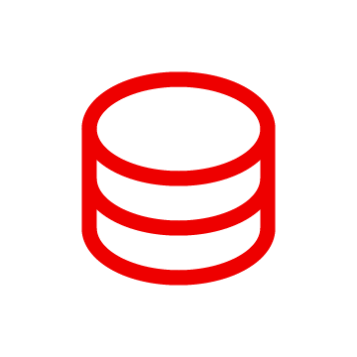


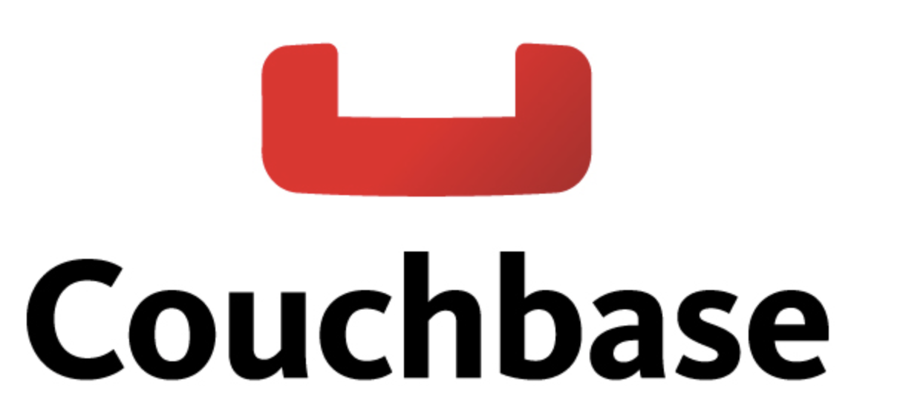




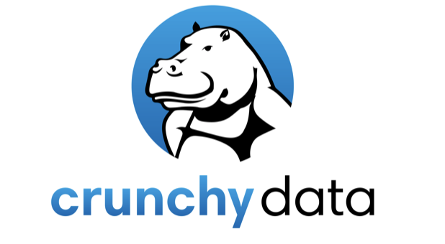

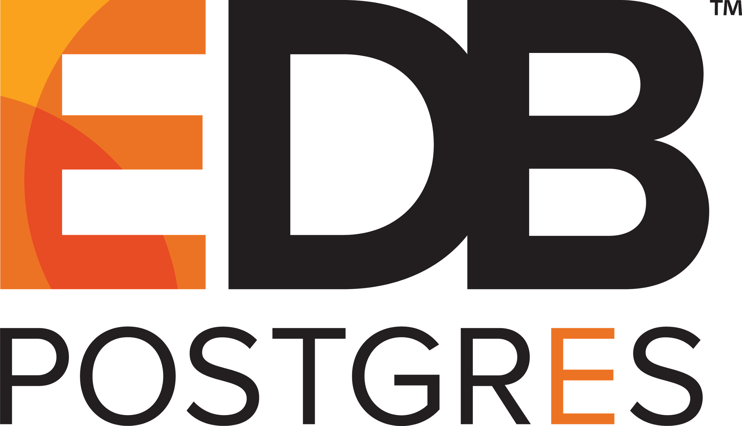

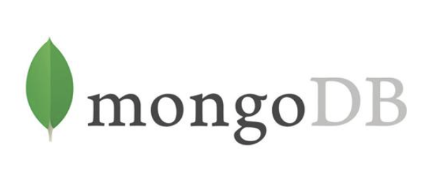
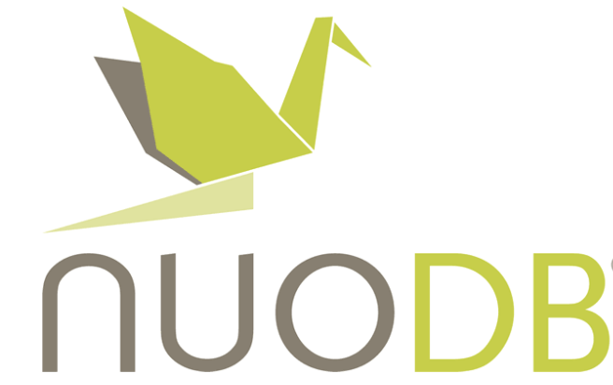








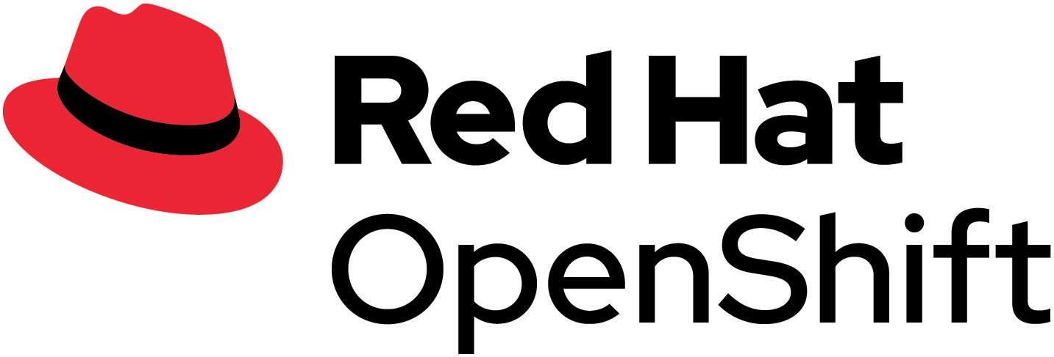
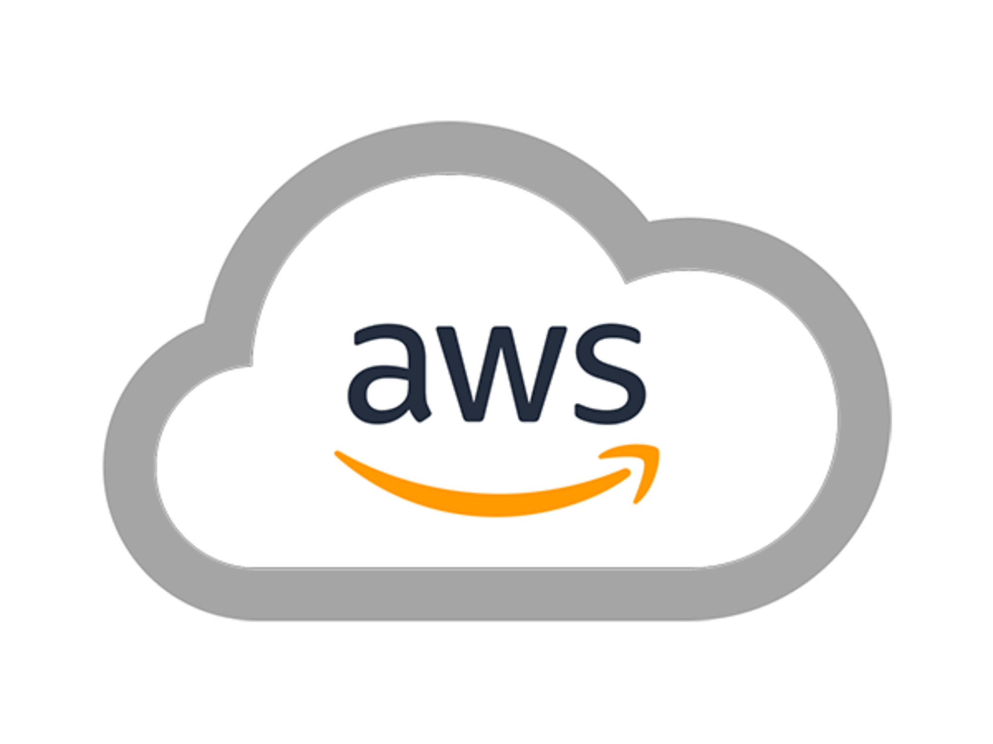
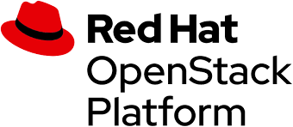

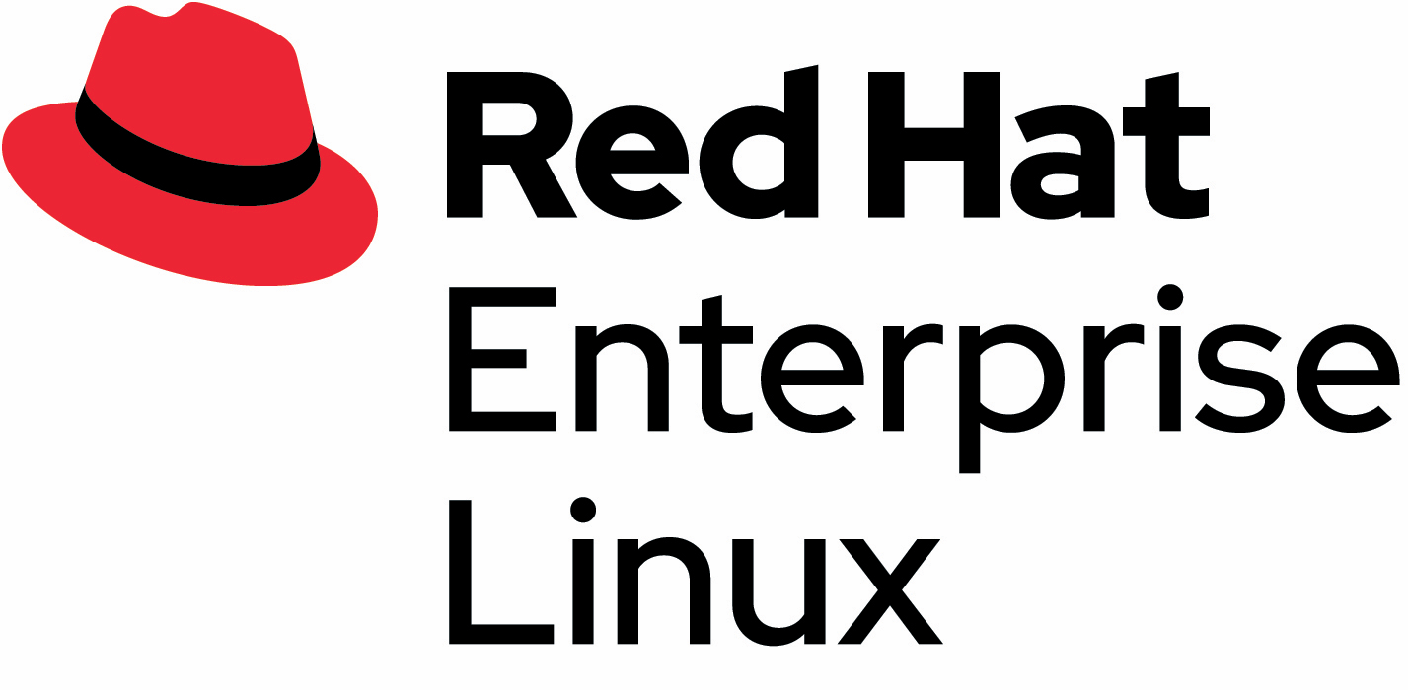
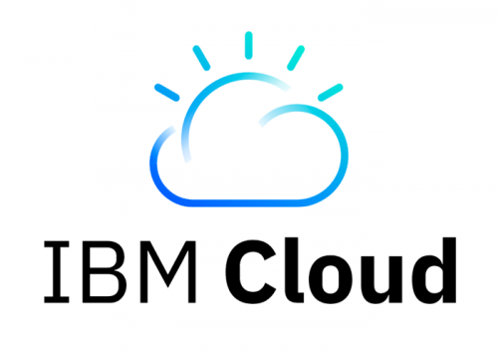

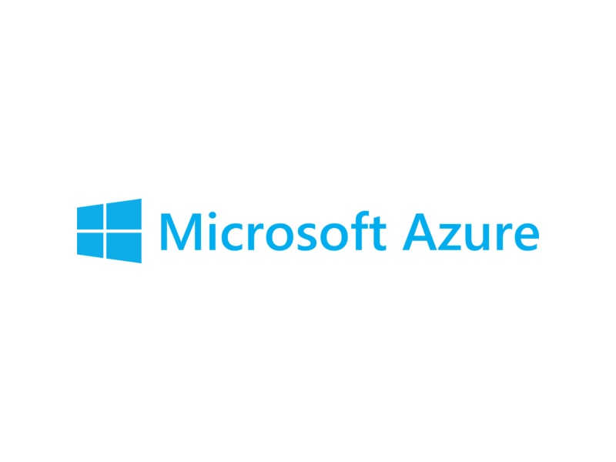
Databases and data analytics on Red Hat OpenShift & ecosystem
Operational database and/or Data Lake
Data preparation (process & transform)
Data ingestion
Analytics Database
Data Analytics
Ecosystem for databases and data analytics tools
Containers and Kubernetes platform
Infrastructure
Notes:
Red Hat OpenShift is equipped to support you in your journey with databases and data analytics.
We have a broad set of ISV ecosystem and strategic integrations to help you simplify and manage databases and data analytics workloads. All of this is enabled by OpenShift and can be run on Red Hat OpenShift.
OpenShift also supports all kinds of footprints such as AWS, Microsoft Azure, IBM Cloud, Google Cloud and Red Hat OpenStack Platform. OpenShift Container Storage can span across various clouds and footprints, built on the strong foundation of RHEL.

Slide 23
Openshift Data Foundation

Slide 24

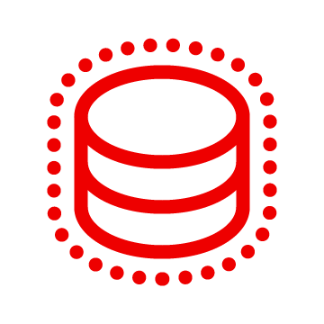

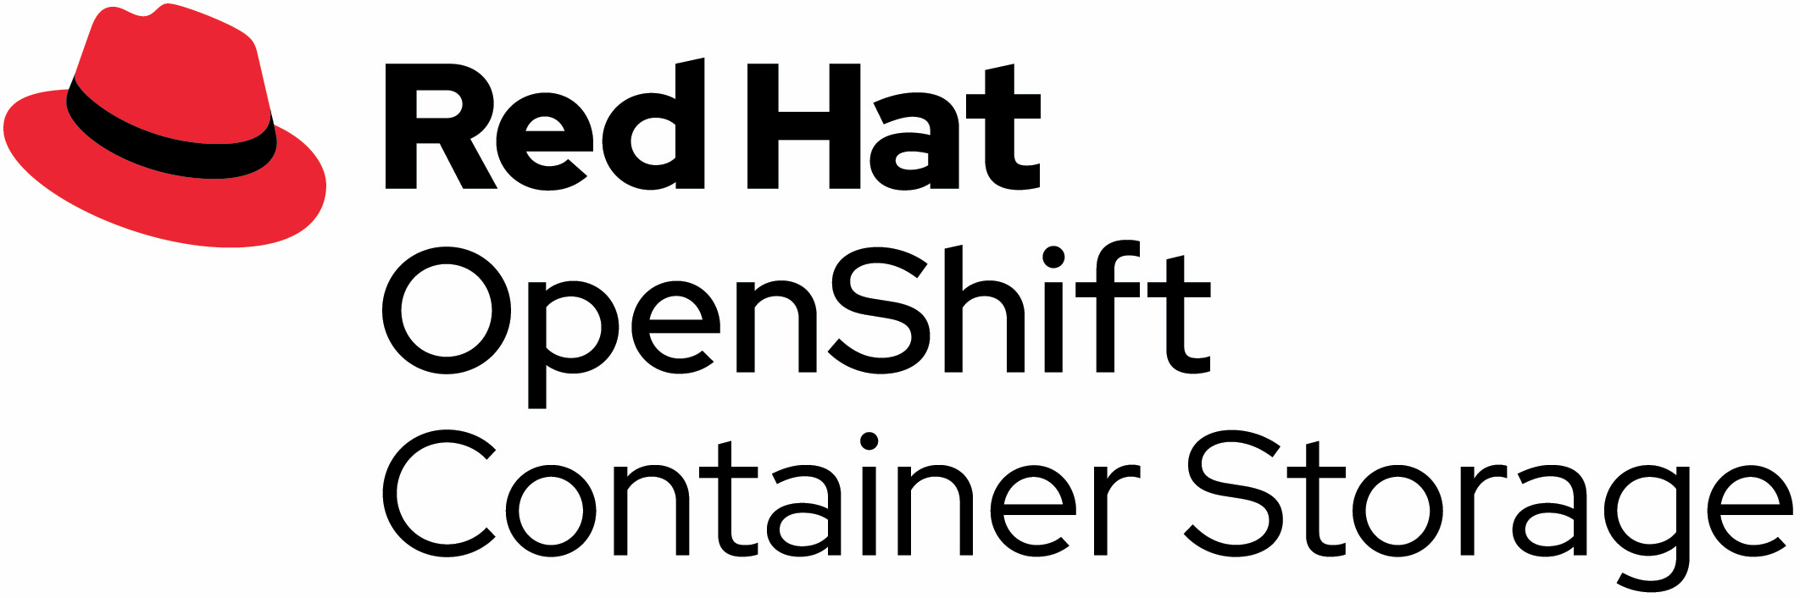


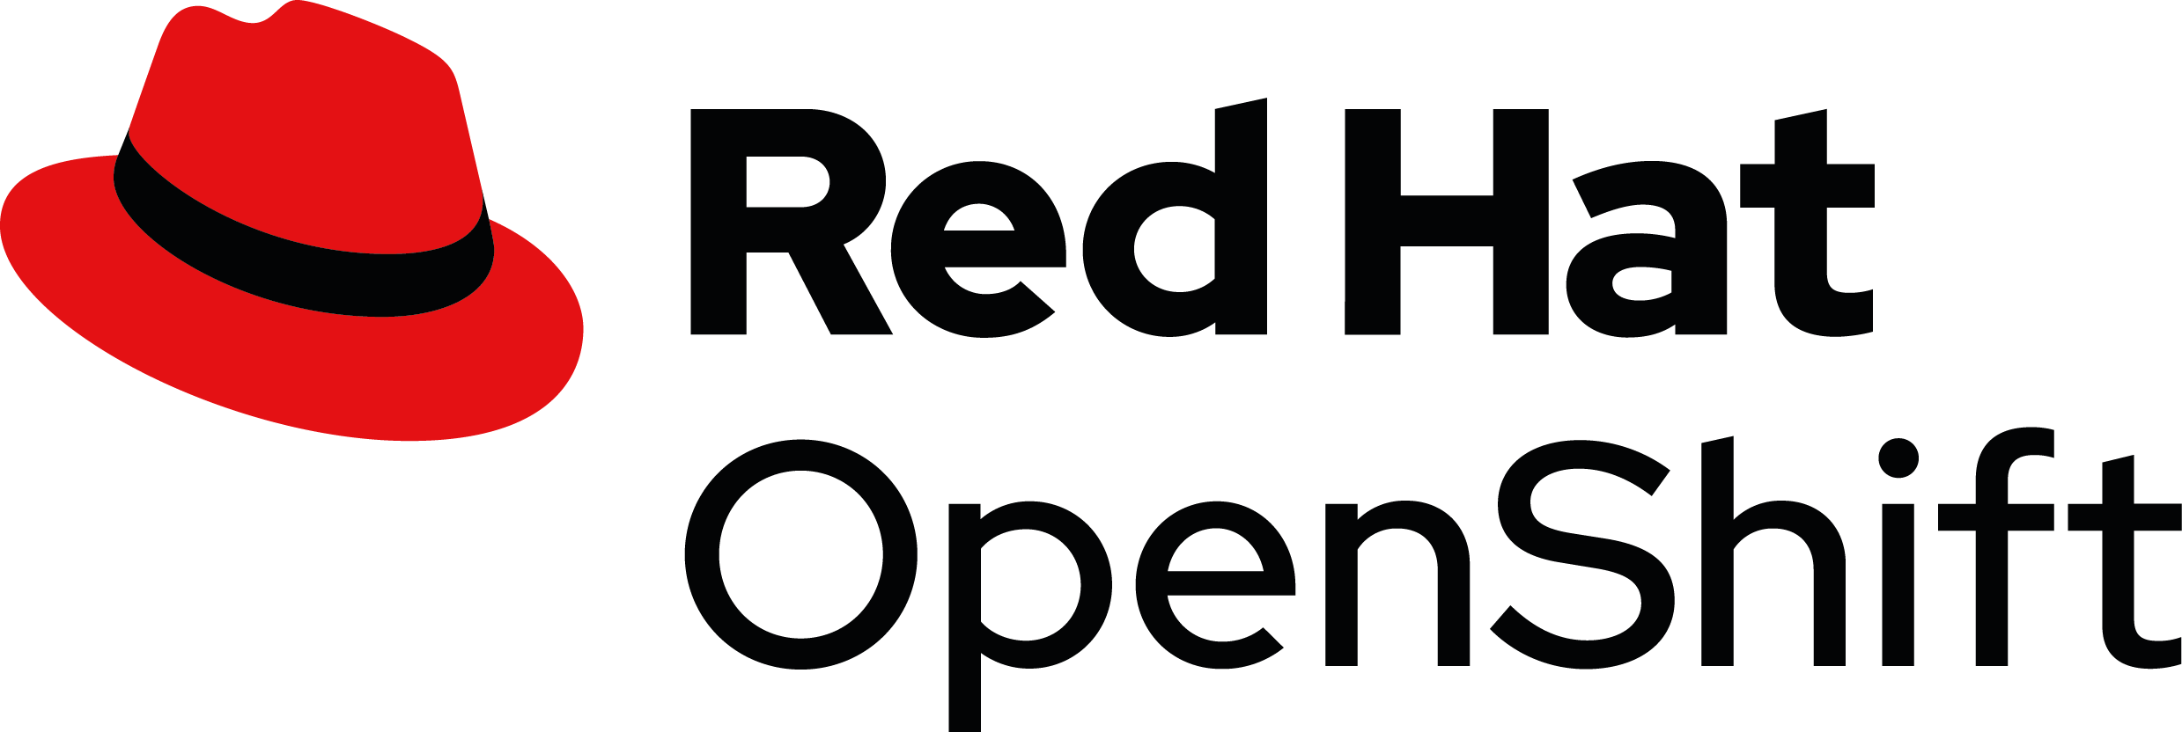

OpenShift Container Storage
Stores all types of data
(structured, semi-structured and unstructured)
Supports multi-cloud/hybrid cloud
(private and public)
Manages storage based on policies
(across clouds)
Simplifies management
(consumed and managed through OpenShift)
Notes:
OCS value with OpenShift
Basic: uniform set of k8s storage services for OpenShift
Unique: natively provides all common storage services, including, file, block, and object
Scalable: based on proven, scale-out Ceph technology, converged or many-OCP:1-OCS
Hybrid: multi-cloud gateway for policy-based data placement across cloud footprints

Slide 25

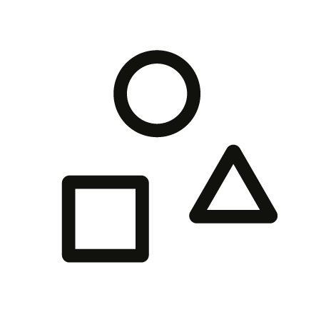
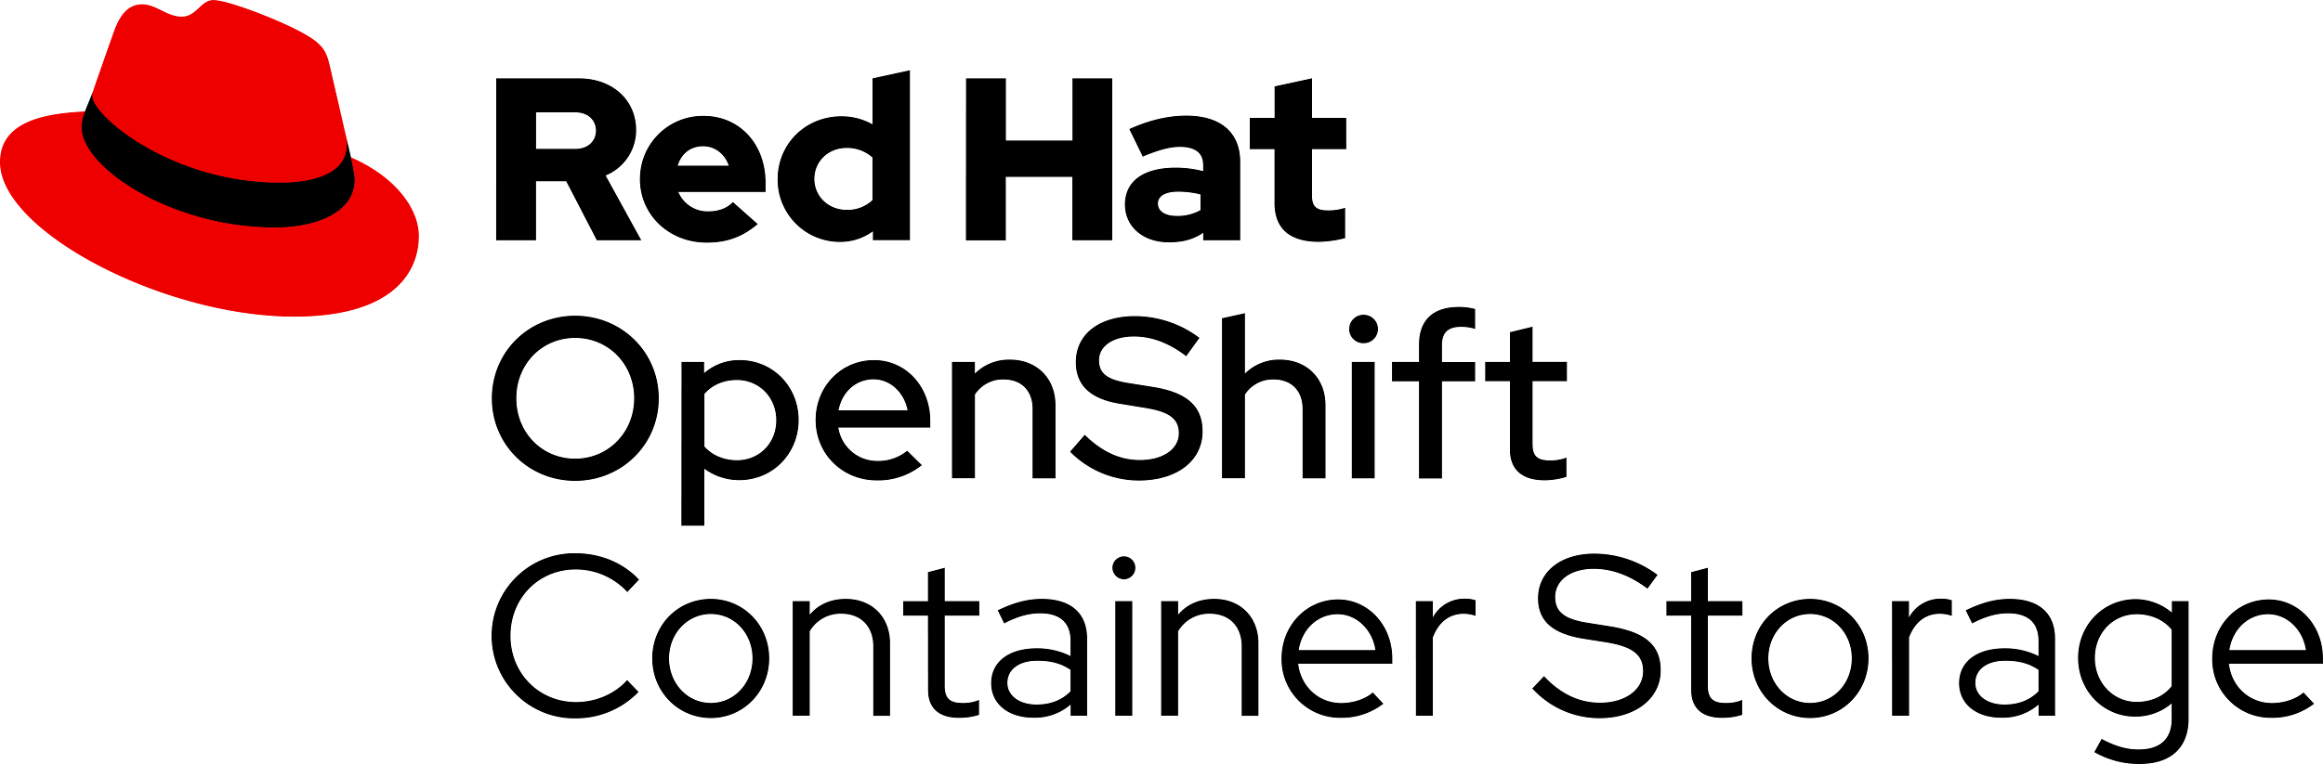
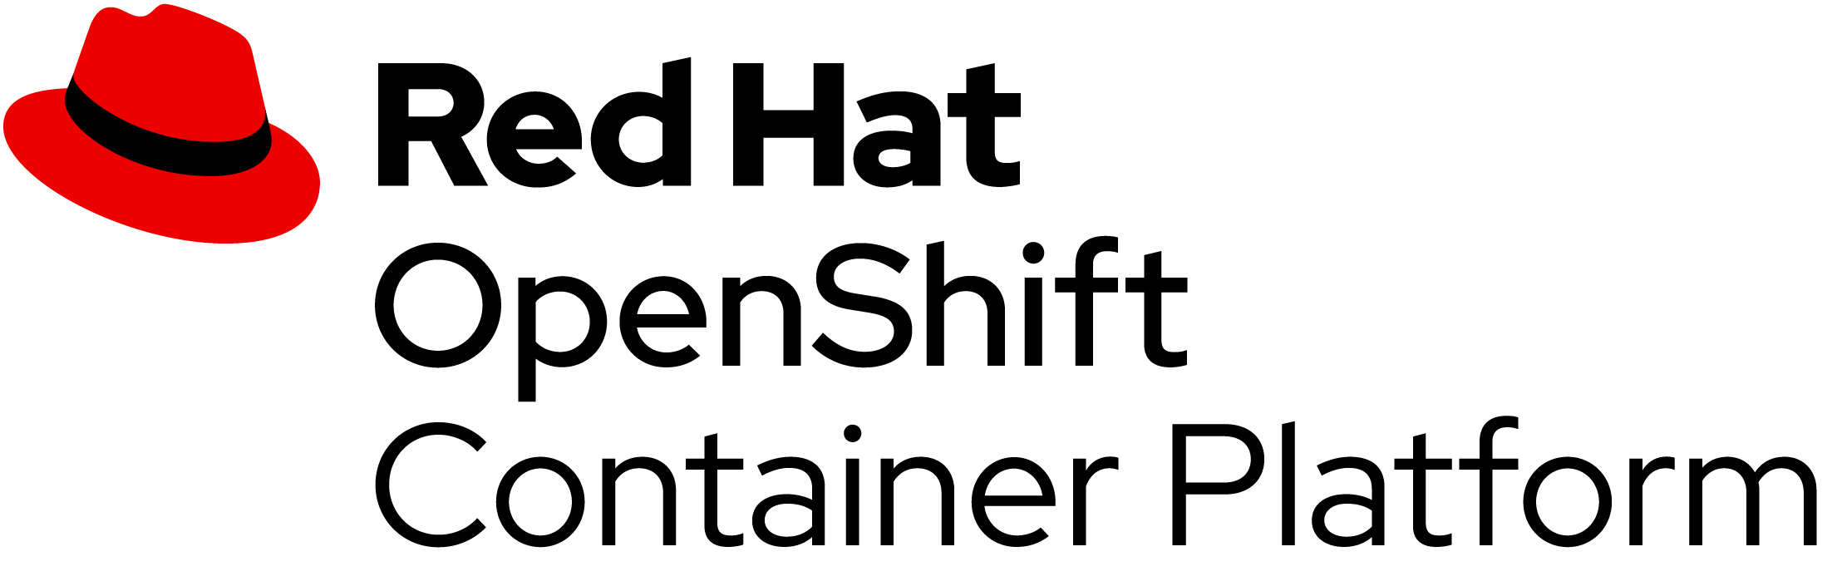





One interface no matter what you’re using
OpenShift Container Storage
The power of the Red Hat portfolio
Unstructured
All types of data
Structured
All types of storage
Block
File
Object
Persistent storage orchestration
Integrated storage management
Container management for enterprise hybrid cloud apps
Unified infrastructure management
Any infrastructure
Physical
Virtual
Private
Hybrid
Public
Edge

Slide 26





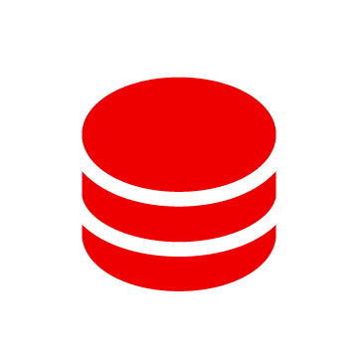


Accelerating workflows with developer-driven storage
OpenShift Container Storage
User requests
Ticket raised
Ticket queued
Traditional way
Storage available
Actioned
Assigned
Wait
Days or weeks
PVC
API-enabled
developer-driven storage
Storage available
Actioned
Almost instantaneous
Notes:
Infrastructure as code means developer-driven storage (instead of create trouble-ticket then wait)
From Red Hat vision perspective, our goal is to give developers the freedom to innovate faster across on-premises, public cloud, and edge by providing them a consistent experience across all these infrastructure footprints.
API Driven Storage + Infrastructure as Code

Slide 27
Use Cases

Slide 28
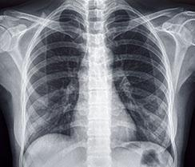



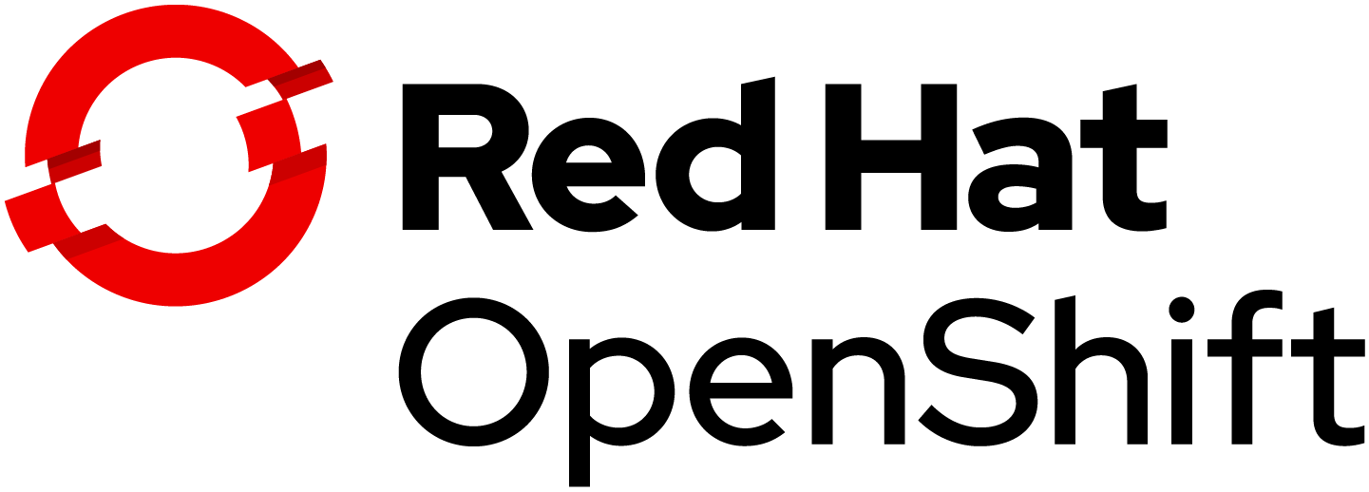
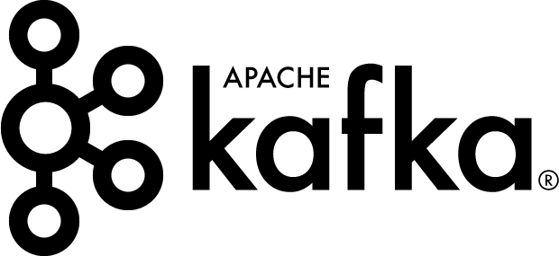
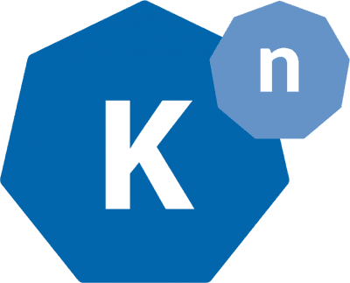
Process automation via bucket notifications
Process triggered by bucket notification
Automated data pipeline using
<30%
No action required
READ
Stamp image
FOLLOW UP
REQUIRED
Archive
30%-80%
R Bradbury
Risk level
R Bradbury
Risk = x%
Treatment reqd
Topic:
Storage
Analysis:
Pneumonia risk
Clinic
Remove PII
>80%
READ
Patient 451
Risk = x%
Pass to research
Research
WRITE
WRITE

Slide 29
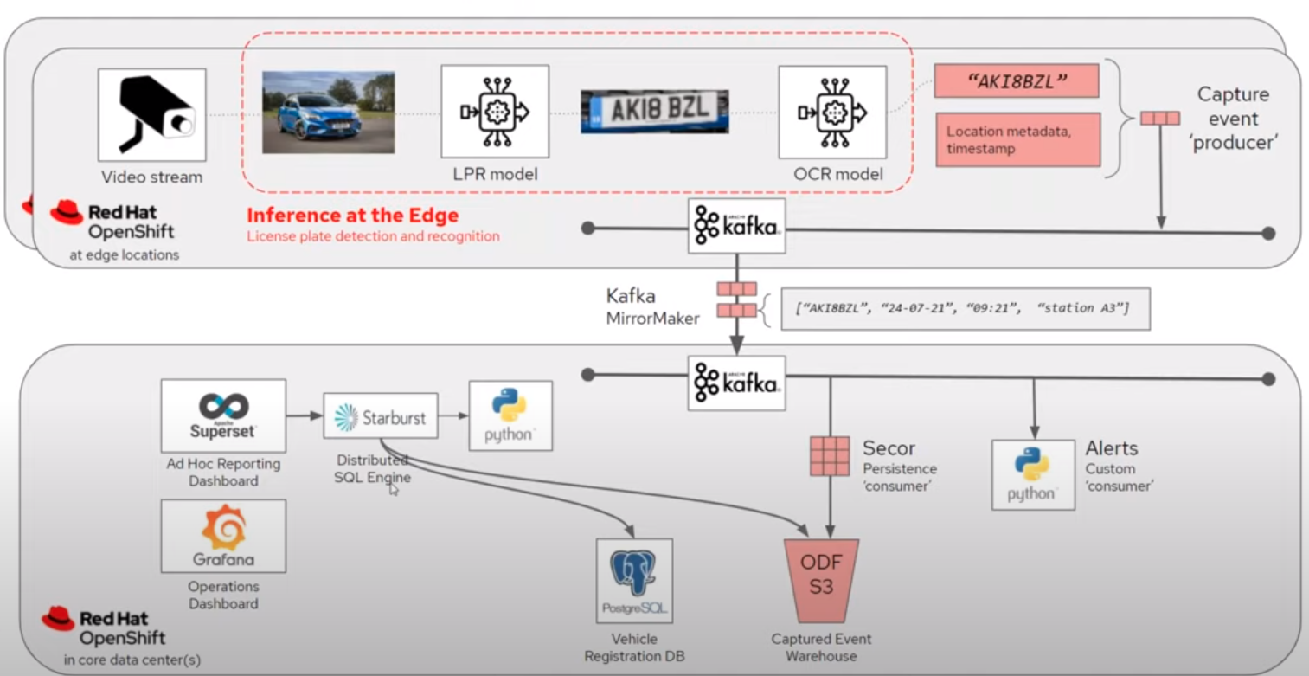
LPR Edge-To-Core Data Story
Notes:
https://www.i-scoop.eu/big-data-action-value-context/data-age-2025-datasphere/

Slide 30

Summary
Databases and data analytics workloads on Red Hat OpenShift
Databases and data analytics are key to cloud-native development
Containers and Kubernetes make cloud-native development successful
Containers and Kubernetes hybrid cloud platform of choice
Mobile apps
eCommerce apps
Internet of Things (IoT) apps
Artificial intelligence and machine learning (AI/ML)
Agility
Scalability
Portability
Automated and simplified operations
Consistency and portability
Partnerships and integrations with ISVs
Notes:
DB and DS are critical to CND
Databases & Data analytics are an integral cog in the cloud-native app dev machine. These workloads are being deployed by organizations globally for mission - critical workloads such as developing mobile apps, eCommerce apps, for processing online transaction, data & business analytics, AI/ML.
Containers and K8S is in the critical path to succeed with CND
For successful and efficient cloud-native app dev, containers and Kubernetes are used to deploy all varieties of workloads. Containers & Kubernetes give the ability to scale in & out based on business requirements, agility to deploy workloads fast and respond quickly. Containers and Kubernetes also make the workloads ready to be ported.
RH OpenShift is the container and k8s platform of choice for databases and data analytics
Automate and simplify operations: Red Hat OpenShift offers a portfolio of databases and data analytics to choose from along with operators that are easily available on Red Hat Marketplace. These operators automate day 1 - 2 operations such as, backup, provisioning etc, leaving the System Administrators free to focus on more strategic tasks important to business.
Consistency and portability across Hybrid Cloud: Secure and consistent deployment of databases, data analytics and all workloads crucial to cloud-native app development. OpenShift offers flexibility by providing a platform across the hybrid cloud, including edge, as well as providing customizable deployment options. Red Hat OpenShift offers a unified, consistent manner of deploying databases, data analytics and all workloads on the same platform.
Key ISV partnerships and integrations: Red Hat has partnerships & integrations with key database and data service ISVs to ensure that operators are available and certified on Red Hat Marketplace.

